Slide 1

PSD Procedures for Responding to Harassment and Discrimination
Shayna Seitchik (she/her) James DiPilato (he/him)

Slide 2
You may access all relevant training flowcharts, graphics, templates, and documents in the TEAMS group below:
  Deputy Nondiscrimination Coordinators | General | Microsoft Teams
    Non-Title IX Templates (C.R.S. 22-1-143)
    Title IX Templates
  Resource Folder with Training Materials
Deputy Nondiscrimination Coordinators List
Know Your Rights Flyer (CRS 22-1-143).pdf
Training Resources & Materials

Slide 3
State and Federal Laws and Regulations

Slide 4
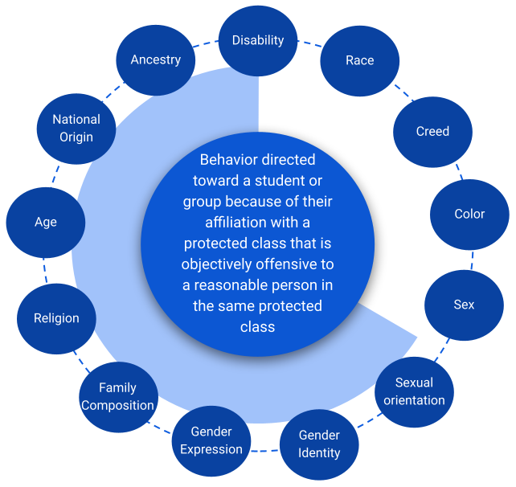
“Require[s] a public school to make a good faith effort to complete an investigation and make any findings within sixty days after [a] report” of harassment or discrimination.”
C.R.S. 22-1-143
Prevent Harassment or Discrimination in Schools

Slide 5
Title IX of the Education Amendments of 1972
“No person in the United States shall, on the basis of sex, be excluded from participation in, be denied the benefits of, or be subjected to discrimination under any educational program or activity receiving federal financial assistance.”

Slide 6

Title IX Scope
Sex discrimination
Discrimination based on sex stereotypes
Discrimination based on sex characteristics
Discrimination based on pregnancy or related conditions
Discrimination based on sexual orientation
Discrimination based on gender identity
Sex-based harassment
TIX Pregnancy and Related Conditions.pdf
TIX Sex-based Harassment.pdf

Slide 7
Incidents that occur outside of a recipient’s (district) educational program/activity or the U.S. that contribute to a hostile environment in the educational program/activity
  Nexus
Clarifies sex discrimination as discrimination based on sex stereotypes, sex characteristics, pregnancy or related conditions, sexual orientation, and gender identity
Sexual harassment hostile environment is defined as Subjectively and Objectively offensive and is so severe OR pervasive that it limits or denies a person’s ability to participate in or benefit from the recipient’s education program or activity
New 2024 Final Title IX Regulations

Slide 8
PSD Procedures
Notes:
Looking at two procedures - tried to make them as complementary as possible while not being bound to as many reports (with identifying information) and timelines if not TIX

Slide 9
C.R.S. 22-1-143 Flowchart
Non-TIX Resolution Procedures.pdf

Slide 10
Title IX Flowchart
TIX Resolution Procedures.pdf
Sex, sexual orientation, sex stereotypes, sex characteristics, gender identity, pregnancy or related conditions

Slide 11
Break

Slide 12
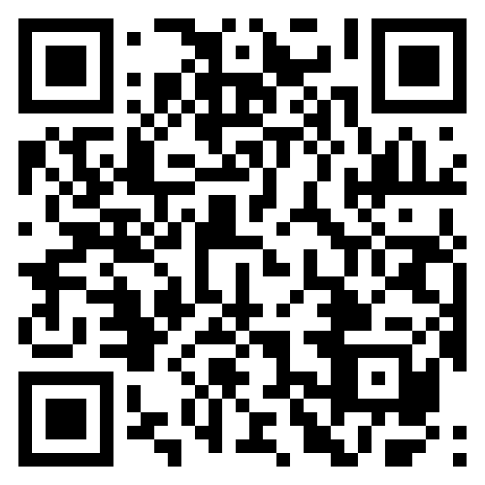
Incident Report Overview
Incident Report Tool Walkthrough.pdf
Staging Environment: https://sweb.psdschools.org/BiasReport/
You will not enter anything into Synergy until the investigation/resolution procedures have been completed and ONLY if the respondent is found responsible

Slide 13
Nondiscrimination Coordinator Roles/Responsibilities

Slide 14
Deputy Nondiscrimination Coordinator (includes TIX)
Principal or Assistant Principal
Receive reports of harassment or discrimination
  Document within Incident Report if not already in Incident Report
Ensure supportive measures are provided and documented within Incident Report
Conduct Initial Assessment
Assign Investigator and Decision-Maker
Ensure Investigation and Decision-Maker/Outcome Reports are uploaded into Incident Report
Support students, staff, and parent/guardians as needed
Coordinate with district supports as needed
Ensure any applicable sanctions/ remedies are implemented

Slide 15
Supportive Measures
Must be offered to both parties
Intended to restore equal access
Must not be punitive or retaliatory
Consider Mental Health Special Services Provider discussing options with student and parent/guardian
Accepted Supportive Measures Template.docx

Slide 16
Initial Assessment
Definitions of Harassment/Discrimination under CRS 22-1-143
  Unwanted behavior toward protected class
  Objectively offensive to member of the same protected class
  Severe or pervasive
Sex-based discrimination under Title IX
  Sex stereotypes, sex characteristics, sexual orientation, gender identity, pregnancy or related conditions
Definitions of Harassment under Title IX
  Quid Pro Quo
  Hostile Environment
  Sexual Assault
    Rape, Incest, Fondling
Jurisdiction
  Related to hostile environment in district’s educational program/activity

Slide 17
Deputy Nondiscrimination Coordinator Responsibilities
Coordinator Responsibilities.pdf

Slide 18
Definition of Fondling
Touching
Private body parts (breast, buttocks, or groin)
Of another person
For the purpose of sexual gratification*
Without consent of the victim

Slide 19
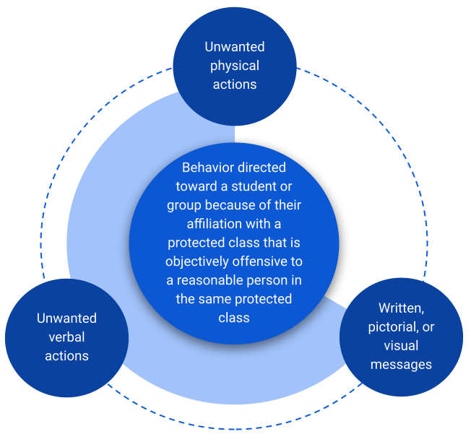
Definition of Harassment or Discrimination in CRS 22-1-143

Slide 20
Initial Assessment Form
Initial Assessment Form 7.25.24.docx
Includes definitions and relevant terms

Slide 21
Retaliation
Attempts to threaten, intimidate, coerce, or discriminate against the Complainant or Respondent due to the formal grievance process
  Can discipline via Code of Conduct

Slide 22
Break

Slide 23
Example Scenarios

Slide 24
Scenario Practice 1
A parent submits an incident report stating that her student was discriminated against because a snow day was not called by the superintendent yesterday, which led to her student being put in an unsafe condition.

Slide 25
Scenario Practice 2
A student submits a report through Incident Report alleging harassment based on gender identity because a teacher repeatedly uses the incorrect name, leading to classmates learning about and/or using the incorrect name. Altogether, the student alleges that they do not feel comfortable going to this class anymore, and they feel harassed by certain students outside of class.

Slide 26
Scenario Practice 3
A student submits a report through Incident Report alleging that another student held a knife to him in the bathroom, forced him to pull his pants down, and touched him inappropriately.

Slide 27
Scenario Practice 4
A group of students is reported as repeatedly using the “n-word” to refer to each other. Staff reports that when they addressed this with the group, all of the students stated that they choose to use this word together and always use it when addressing their friends.

Slide 28
Scenario Practice 5
Reports of bullying in reference to:
A student’s weight and
This student being a virgin

Slide 29
Bullying and Harassment/
Discrimination
When reviewing whether behavior is bullying or harassment/discrimination, consider whether the bullying is related to an individual's protected class:
Disability, Race, Creed, Color, Sex, Sexual Orientation, Gender Identity, Gender Expression, Family Composition, Religion, Age, National Origin, Ancestry.
  If so, follow the C.R.S. 22-1-143 or Title IX process

Slide 30
Scenario Practice 6
TikTok trend – group of students slapping each other’s buttocks
A group of nonbinary students report that they do not have access to facilities on a school trip because the location has segregated male and female dormitory rooms, locker rooms, and/or restrooms

Slide 31
Investigator Roles/Responsibilities

Slide 32
Investigator(s)
Investigating whether a policy violation occurred
  Maintaining impartiality and avoiding prejudgement
Gather and review directly related evidence
Interview Complainant, Respondent, witnesses
Write Relevant Evidence Report and send to both parties (Only for TIX)
Write Investigation Report and send to decision-maker
Consider or ask about co-investigator model when staff is listed as respondent or sexual assault is alleged

Slide 33
Relevant Evidence
Does the evidence tend to prove (inculpatory) or disprove (exculpatory) the respondent was responsible for the allegation?
Not Relevant (under TIX)
  Treatment records, unless parties agree
  Legally privileged information
  Questions or evidence about a complainant’s prior sexual predisposition or behavior unless specifically between the complainant and respondent

Slide 34
Interview Tips
Explain role
  Wearing a different hat
  Difficult questions/topics
Be curious
Draft questions in advance
Who, what, where, when, why
Clarity on timelines
Repeat and rephrase statements and questions for understanding
Remind parties that it is okay to say, “I do not know.”
Provide breaks as necessary
Remind parties of Retaliation

Slide 35
Advisors
Both parties have the right to an advisor
  Students should always have the right to have a parent/guardian present and may have an additional advisor
Can advise complainant/respondent of rights and procedures
Can ask for a pause during interviews
Cannot answer questions directly on behalf of the complainant/respondent
Should not continually interrupt questions from investigator or responses from complainant or respondent unless asking for a pause to consult with complainant or respondent
  Investigator has authority to stop and reschedule interview if necessary

Slide 36
Interview, Directly Related Evidence, and Investigation Reports and Documentation
C.R.S. 22-1-143 (Non-Title IX)
Interview Documentation (Non-Title IX).docx
Investigation Report Template (Non-Title IX).docx
Title IX
Title IX Interview Documentation Template 7.25.24.docx
Title IX Relevant Evidence Report 7.25.24.docx
Title IX Investigation Report (2024) 7.25.24.docx

Slide 37
Decision-Maker Roles/Responsibilities

Slide 38
Decision-maker(s)
Reviews investigation report, evidence, and facilitates any follow-up questions of parties
  For questions, start with investigator first, document, including if no response from parties
Conducts an independent assessment of the evidence, including assessment of credibility of both parties and witnesses
Determines whether respondent is responsible for alleged behavior and a violation of district policy by employing the preponderance of evidence standard
Determines any appropriate sanctions and/or remedies
Writes and send decision-maker/outcome report to all parties

Slide 39
Remain neutral and objective
Avoid pre-judgment
Report any observed or perceived biases to the Nondiscrimination/Title IX or Deputy Nondiscrimination/Title IX Coordinator
Bias

Slide 40
Look for and note consistencies and inconsistencies
  Statements
  Written Reports
  Evidence Reports
Credibility / Consistency

Slide 41
Regulations define the following as NOT relevant (TIX)
  Medical treatment records unless both parties agree
  Privileged information
  Questions and evidence about the complainant’s sexual predisposition or prior sexual behavior unless they are offered to prove that someone other than the respondent committed the sexual harassment, or if the questions and evidence concern specific incidents of the complainant’s prior sexual behaviors with the respondent and are offered to prove consent
Ordinary meaning
  Does the evidence tend to make a fact more or less likely to be true?
    Is it related to this specific situation?
    Is it going to help me determine whether this situation happened or not?
  Inculpatory- Suggests respondent is responsible
  Exculpatory- Suggests respondent is not responsible
Relevancy

Slide 42
Greater than 50% chance the Respondent is Responsible for the alleged conduct/policy violation
  More likely than not
  50% plus a feather
Preponderance of Evidence Standard

Slide 43
Consider type of evidence when engaging in fact finding
More likely to meet preponderance of evidence standard
  Direct Information
  Documentary Information
Less likely to meet preponderance of evidence standard
  Circumstantial Information
  Hearsay Information
Is the information disputed?
  If no, this information can be considered a fact
Does the other evidence corroborate the information?
    Consistencies
    Inconsistencies
Evaluating Witness/Reviewing Evidence
  Focus on behavior, not character
Fact Finding

Slide 44
Sanctions for Respondent should almost always include positive interventions (i.e. education, training, behavioral intervention, intervention plan(s), restorative practices if appropriate)
  Disciplinary actions may include suspension, expulsion, involuntary administrative transfer, involuntary class/schedule change, restricted access to activities, etc.
Remedies for Complainant should restore equal access and may look similar to supportive measures (i.e. regular meetings with support staff, hallway escorts, academic support, mutual no contact agreements)
Sanctions/
Remedies

Slide 45
Outcome of Investigation and Decision-Maker Reports and Documentation
C.R.S. 22-1-143 (Non-Title IX)
Interview Documentation (Non-Title IX).docx
Outcome of Investigation Report (Non-Title IX).docx
Title IX
Title IX Interview Documentation Template 7.25.24.docx
Title IX Decision-Maker Report (2024) 7.25.24.docx

Slide 46
Appeals & Intersections

Slide 47
Either party can appeal the decision/outcome within 5 business days of it being emailed
Three allowable grounds:
  Procedural Irregularity
  New evidence that was not reasonably available
  Bias/conflict of interest from coordinator, investigator, and/or decision-maker
Appeals will be handled at the district level
Title IX Appeal Report 7.8.2024.docx
Appeals

Slide 48
The Title IX process is primarily used if a student or employee chooses to file a complaint under Title IX (there are some exceptions when a district TIX coordinator would file). Employers have an obligation to investigate complaints that are related to Title VII.
Student to Student – In most cases, the school administration team will serve as investigator and decision maker.
Student & Employee – Contact your HRBP. The Title IX investigation process will be used in collaboration between the school and district support, and the investigation report is sent to HR, where an HR rep will serve as the decision maker
Employee to Employee – Contact your HRBP. HR will use the Title IX process for sexual harassment allegations, and the Title VII workplace investigation process to look into other forms of discrimination. HR will coordinate with the school site to address any finding.
Note on Title VII’s Intersectionality with Title IX

Slide 49
James DiPilato
  jdipilato@psdschools.org
Shayna Seitchik
  sseitchik@psdschools.org
Contact Information:
District Title IX & Nondiscrimination Compliance Coordinators

